Slide 1
Advanced Topics Non-linear least squares regression

Slide 2
Goals
Introduce non-linear functions in ecology and evolutionary biology
Fit a non-linear model in R using least squares

Slide 3
Review – linear regression
Linear relationships assume a linear relationship between our predictor and our dependent variable
What is the equation for a basic linear model?
We use lm() to make linear models in R.
Fit using least squares
What does this assume?

Slide 4
Non-linear relationships
Sometimes we have a non-linear relationship between a predictor and a response variable
Notes:
What are these different responses?

Slide 5
Non-linear functions
Non-linear functions are variable across fields
Can have non-linear functions where parameters have very specific meaning
e.g. Type II Holling functional response
Can have non-linear functions which take a “shape” that fits your data
Application of the above function to non-predator prey dataset

Slide 6
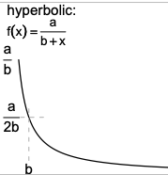
Hyperbolic functions
Used in models of plant competition to fit seed production as a function of plant density
Mechanistic understanding: if resources per unit area are constant, the area available to the plant for resource exploitation might be proportional to 1/plant density

Slide 7
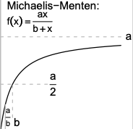
Michaelis-Menten function
Introduced for enzyme kinetics, but used for lots of things
Resource competition (called Monod function)
Fisheries biology (called Beverton-Holt model, mortality rate~density)
Predator-prey dynamics (called what?)
Starts at 0 when x=0, and approaches asymptote as a gets large
Asymptote occurs ”slowly”: (x/1+x) is halfway to asymptote when x=1, 90% when x=9

Slide 8
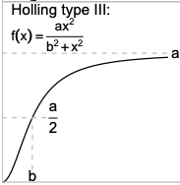
Holling type III response
Slightly more S shaped than the type II response
Can occur due to predator switching

Slide 9
Exponential functions

Slide 10
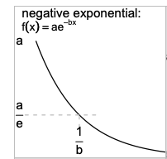
Simple exponentials
Exponential growth
ae^(bx)
Exponential decay
ae^(-bx)
Also called:
“catalytic curve” change in the fraction of a cohort exposed to a pathogen
“von Bertalanffy” growth curve – effect of size on metabolic rate
“Skellam model” – population ecology as number of offspring in next year as a function of the number of adults this year
Two parameter functions – a is the starting or final size, and the exponential rate “b”
How could we fit this using the “lm” function?

Slide 11
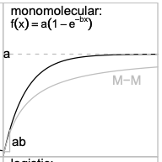
Monomolecular exponential
Saturating growth
Multiplier is a, final pop size
Exponential rate “b” – the time needed to reach e time the initial value
M-M is the michaelis-menten

Slide 12
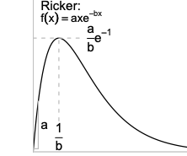
Ricker function
Can reflect density-dependent population growth (pop size on x, growth rate on y)
Very widely used for ecological variables that start at 0, increase to a peak, and decrease gradually toward 0

Slide 13
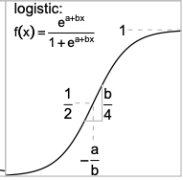

Logistic function
There are different way to parameterize the logistic function
In population ecology, more commonly written as:
K is carrying capacity, n0 is pop size at time=0, and r is per capita growth rate

Slide 14
There are many, many, many non-linear functions
See resources on Canvas

Slide 15
Fitting non-linear functions in R
The most commonly used package for fitting non-linear functions with least squares is “nls()”
What assumptions must we meet?

Slide 16
Using nls
To use nls, we must
(1) input a formula, including our parameters
(2) input some starting vales
(3) cross our fingers that we have generally chosen starting values well

Slide 17
Comparing model fits
It can be difficult to compare non-linear model fits
One way to do this is the mean squared error
mean(resid^2)
If you are using the same data and predictors, you want the lower value

Slide 18
Go to R…

Slide 19
Exercise
Working in group, identify a non-linear relationship in your data or theirs
Identify whether any of the functions you learned about today would apply to these relationships

